Slide 1


A VUCA World: Presentation 2
Professional Capabilities for a Digital World

Slide 2
This session’s objectives
Define & characterise the VUCA World
Explore the evolution of the VUCA World concept
Explore each of the 4 constructs and ways to address them
Identify critical factors for navigating the VUCA World
Explore opportunities for further research and practice
Wrap up the topic with a useful overview video
Attempt a 1-Minute paper exercise on the VUCA World concept
Be more knowledgeable leaving than arriving
Notes:
2

Slide 3
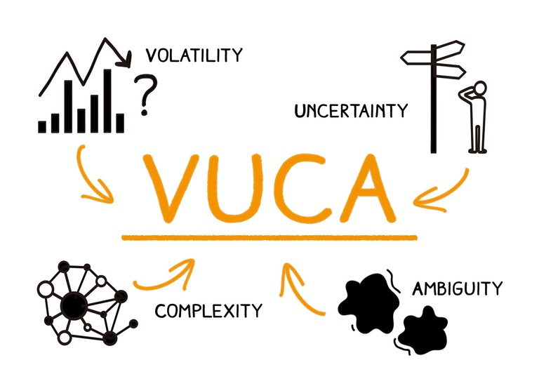
The VUCA World
Notes:
3

Slide 4
The VUCA World
It’s VOLATILE
It’s UNSTRUCTURED
It’s COMPLEX
It’s AMBIGUOUS
By definition, if you are not CONFUSED, you are not paying attention. Confusion is part of the game. AND actually, being frightened is a part of the game too. But you cannot stay frightened, or you will freeze and lose the game (Johansen & Euchner 2013)
Notes:
4

Slide 5
Evolution of the VUCA term
~1987/88 VUCA, placed into curriculum at the US Army War College
"Developing Strategic Leadership: The US Army War College Experience," …defining strategic leadership within a "volatile, uncertain, complex and ambiguous global environment..." (p. 8).
USAHEC 2018
The Army War College derived these ideas from the writings of Bennis and Namus and cited the book: Leaders: The Strategies for Taking Charge (Bennis & Nanus 1985).
Notes:
5
U.S. Army Heritage and Education Center, 2018, Who first originated the term VUCA (Volatility, Uncertainty, Complexity and Ambiguity)?, USAHEC Ask Us a Question, The United States Army War College, viewed 27 Asugust 2020, < https://usawc.libanswers.com/faq/84869>.
Bennis, W. and Nanus, B, 1985, The strategies for taking charge, Leaders, New York: Harper.

Slide 6
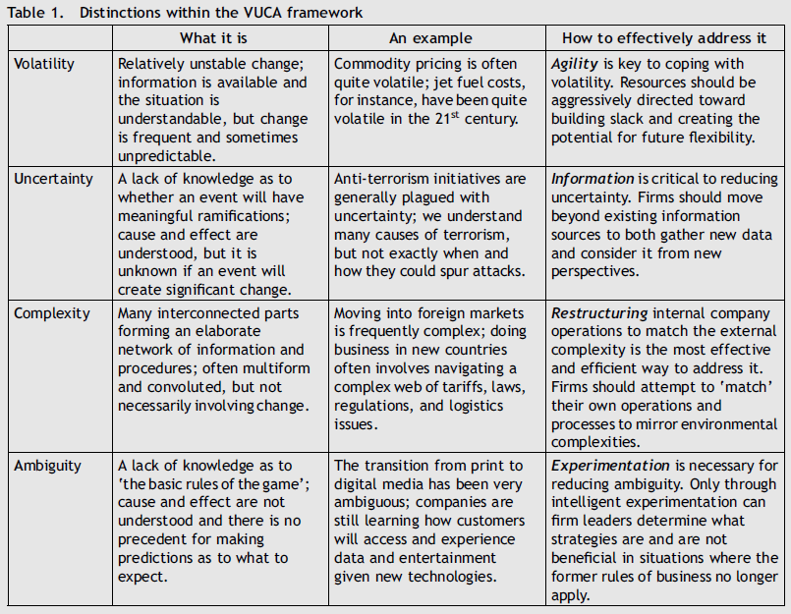
Notes:
6
Bennett, N & Lemoine G.J 2014, What a difference a word makes: Understanding
threats to performance in a VUCA world, Organizational Performance, Business Horizons (2014), 57, pp. 311—317.

Slide 7
Critical factors for navigating the VUCA World
Sound business fundamentals;
Innovation & Fast-paced response;
Flexibility & Change management;
Managing diversity – at both local and global level;
Market intelligence; and
Strong collaboration with all relevant stakeholders – employees, customers, suppliers, shareholders and the broader society.
Leaders, from CEOs to any other internal manager, therefore, have a major role to play in ensuring their organizations are responding to the requirements of the VUCA business environment (Sarkar 2016)
Notes:
7
Sarkar, A., 2016. We live in a VUCA World: The importance of responsible leadership. Development and Learning in Organizations: An International Journal.

Slide 8
VUCA World Implications.
Three implications for research and practice on agile and sustainable organizations in volatile, uncertain, complex, and ambiguous (VUCA) environments.
First, how to characterize the COVID virus and our response to it is unclear; what is clear is that we were unprepared.
Second, despite the rhetoric, too many organizations did not have the capabilities to respond. Saying you are agile does not make it so.
Third, the COVID-19 pandemic reveals our community’s silence on structural inequality (e.g., financial, social, and racial). We enabled unethical positions from the safety of our positivistic and supposedly neutral values
Notes:
8
Worley, C.G & Jules, C 2020, COVID-19’s Uncomfortable Revelations About Agile and Sustainable Organizations in a VUCA World, The Journal of Applied Behavioral Science, 56(3) pp. 279–283.

Slide 9
Not all Doom & Gloom but more attention required.
‘‘Volatility provides profit opportunity” (Warwick-Ching, 2013)
‘‘Uncertainty is opportunity’’ (Hemingway & Marquart, 2013)
‘‘Simplifying IT complexity [is] a major opportunity.’ (Boston Consulting Group, 2013)
‘‘Ambiguity equals opportunity.’ (Amerasia Consulting Group, 2013)
Effective approaches to dealing with VUCA require a better understanding of and coordination between those two levels
Leaders themselves, as individuals, are affected by the VUCA environment, as volatility may have a detrimental effect on the well-being and (mental) health of CEOs, managers, and entrepreneurs .
Notes:
9
Millar, C., Groth, O and Mahon, J 2018, Management Innovation in a VUCA World: Challenges and Recommendations, California Management Review, 61(1), pp. 5–14.

Slide 10

Notes:
https://youtu.be/L1VJoifaTZY
Deloitte 2017, The World of VUCA Series: Introduction to the "World of V.U.C.A."

Slide 11

VUCA Worlds – Your Takeaway.
Notes:
11

Slide 12
Have we met our objectives.
Defined & characterised the VUCA World
Explored the evolution of the VUCA World concept
Identified critical factors for navigating the VUCA World
Explored each of the 4 constructs and ways to address them
Explored opportunities for further research and practice
Wrapped up the topic with a useful overview video
Attempted a 1-Minute paper exercise on the VUCA World concept
Become more knowledgeable leaving than arriving
Notes:
12

Slide 13
Some References.
Bennett, N & Lemoine G.J 2014, What a difference a word makes: Understanding threats to performance in a VUCA world, Organizational Performance, Business Horizons (2014), 57, pp. 311—317.
Bennis, W. and Nanus, B, 1985, The strategies for taking charge, Leaders, New York: Harper.
Deloitte 2017, The World of VUCA Series: Introduction to the "World of V.U.C.A.“, viewed 28 August 2020, < https://youtu.be/L1VJoifaTZY >.
Johansen, B and Euchner, J 2013, Navigating the VUCA World, Research-Technology Management, 56, pp. 10-15.
Millar, C., Groth, O and Mahon, J 2018, Management Innovation in a VUCA World: Challenges and Recommendations, California Management Review, 61(1), pp. 5–14.
Sarkar, A., 2016. We live in a VUCA World: The importance of responsible leadership. Development and Learning in Organizations: An International Journal.
U.S. Army Heritage and Education Center, 2018, Who first originated the term VUCA (Volatility, Uncertainty, Complexity and Ambiguity)?, USAHEC Ask Us a Question, The United States Army War College, viewed 27 August 2020, < https://usawc.libanswers.com/faq/84869 >.
Worley, C.G & Jules, C 2020, COVID-19’s Uncomfortable Revelations About Agile and Sustainable Organizations in a VUCA World, The Journal of Applied Behavioral Science, 56(3) pp. 279–283.
Notes:
13

Slide 14


